Slide 1
HIDS-7006: AI for Health Applications
Week 8: Introduction to Text representation and classification
02/29/2024
Samir Gupta, PhD

Slide 2
Introduction to text representation for ML
What is involved?

Slide 3
Text Representation
Machine do not understand text
Set of techniques that learn a feature from a lexical unit
Word, sentence, paragraph, document
Transformation of the raw data input to a representation that can be effectively exploited in ML tasks.
The mapping from textual data to real valued vectors is called feature extraction.

Slide 4
Typical ML Pipeline for text
Raw Text
Text Preprocessing
Split into language units
Mathematical representation of language unit
ML Models
The first and arguably most important common denominator across all NLP tasks:
How we represent text as input to out ML model?

Slide 5
Approaches
Represent words as discrete symbols
Bag-of-words
Frequency based (TF-IDF)
Represent words by their context
Distributional Semantics (Word Embeddings)

Slide 6
Bag-of-word representation
One-hot encoding

Slide 7
Bag-of-words
Represent words as discrete symbols
Localist representation
Encode position in the vocabulary
Vocab = [w1, w2, w3, w4, w5 …, w_{n-3}, w_{n-2}, w_{n-1}, w_{n}]
One-hot vectors
w1 = [1 0 0 0 0 … 0 0 0 0]
w2 = [0 1 0 0 0 … 0 0 0 0]
The encoding of a given word is simply the vector in which the corresponding element is set to one, and all other elements are zero.

Slide 8
1-of-N Encoding
lexicon = {nausea, vomiting, diarrhea, rash, headache}
nausea = [ 1 0 0 0 0]
The vector is lexicon size.
vomiting = [ 0 1 0 0 0]
Each dimension corresponds to a word in the lexicon
diarrhea = [ 0 0 1 0 0]
rash = [ 0 0 0 1 0]
The dimension for the word is 1, and others are 0
headache = [ 0 0 0 0 1]

Slide 9
Issues with Bag-of-words (1)
Vector dimension = Size of lexicon/Vocabulary
Very large number of features/dimensions
Length of the vector might be thousands or millions of positions
This results in a vector with lots of zero scores, called a sparse vector or sparse representation.
Sparse vectors require more memory and computational resources when modeling and the very large dimensions can make the modeling process very challenging for traditional algorithms.

Slide 10
Issues with Bag-of-words (2)
Example: in web search, if user searches for “lung cancer”, we might like to match documents containing “lung neoplasm”
But:
cancer = [0 0 0 0 0 0 0 0 0 0 1 0 0 0 0]
neoplasm = [0 0 0 0 0 0 0 1 0 0 0 0 0 0 0]
These two vectors are orthogonal.
There is no natural notion of similarity for one-hot vectors

Slide 11
Solution
Instead: learn to encode similarity in the vectors themselves
lung
heart
Word2vec : Word Embeddings
Developed by Google (Mikolov et al. 2013)
A Framework for learning word vectors based on semantics
pain
fever
aspirin
ibuprofen
inflammation
Question: How would encode such similarity automatically?

Slide 12
Lab 8
Text Classification using Bag-of-words
Identifying Adverse Drug Event from Twitter posts

Slide 13
Distributional Semantics
Word Embeddings based on context

Slide 14
Distributional Semantics
A word’s meaning is given by the words that frequently appear close-by
“You shall know a word by the company it keeps”
One of the most successful ideas of modern statistical NLP!

Slide 15
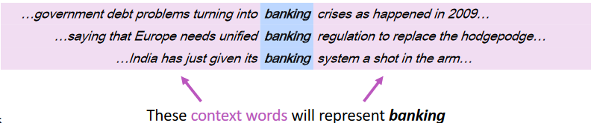
Representing words by their context
When a word w appears in a text, its context is the set of words that appear nearby (within a fixed-size window)
Use the many contexts of w to build up a representation of w

Slide 16
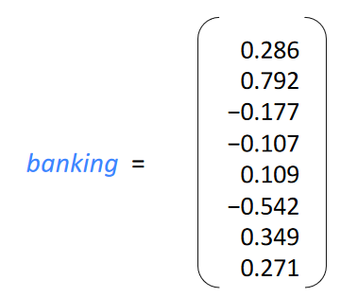
Word vectors
We will build a dense vector for each word, chosen so that it is similar to vectors of words that appear in similar contexts
E.g: “banking” and “investing”
Note: word vectors are sometimes called word embeddings or word representations.

Slide 17
Learning Word vectors: Word2vec
Word2vec (Mikolov et al. 2013) is a framework for learning word vectors
Idea
We have a large corpus of text
Every word in a fixed vocabulary is represented by a vector
Go through each position in the text, which has a center word c and context (“outside”) words o
calculate the probability of o given c (or vice versa)
Keep adjusting the word vectors to maximize this probability

Slide 18
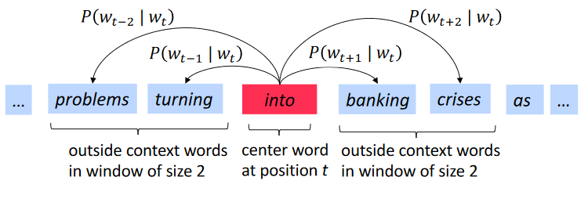
Word2Vec Overview
Example windows and process for computing P(w_{t+j} | w_{t})

Slide 19
Word2vec: The Skip-Gram Model
Many ways to learn word vectors by maximizing the context word probability
We will cover one such approach: Skip-Gram Model

Slide 20
Skip-Gram Model : High Level Insight
Uses a trick you may have seen elsewhere in machine learning.
Train a simple neural network with a single hidden layer to perform a certain task

Slide 21
Skip-Gram Model : High Level Insight
Uses a trick you may have seen elsewhere in machine learning.
Train a simple neural network with a single hidden layer to perform a certain task
But then we’re not actually going to use that neural network for the task we trained it on!
The goal is something else (more on this later)

Slide 22
Trick: Fake Classification Task
Train the neural network to do the following:
Given a specific word (w) in the middle of a sentence (the input word)
look at the words nearby and pick one at random (t)
Network is going to tell us the probability for every word in our vocabulary of being the “nearby word” that we chose: P (t|w)
Training example <w,t>
w is the input
t is the output label

Slide 23

Example: Training Samples (window size =2)

Slide 24
What is the model learning?
Learn the statistics from the number of times each pairing shows up
network is probably going to get many more training samples of (“lung”, “cancer”) than it is of (“lung”, “sasquatch”).
When the training is finished, if you give it the word “lung” as input
It will output a much higher probability for “cancer” or “metastasis” (why?)
THAN
it will for “Sasquatch”

Slide 25
How to train?
Can’t feed a word just as a text string to a neural network
So how do we train?

Slide 26
Model Details
Can’t feed a word just as a text string to a neural network
First build a vocabulary of words from our training documents
let’s say we have a vocabulary of 10,000 unique words.
Represent an input word like “cancer” as a one-hot vector
This vector will have 10,000 components (one for every word in our vocabulary)
The output of the network is a single vector (also with 10,000 components)
For every word in our vocabulary, the probability that a randomly selected nearby word is that vocabulary word.

Slide 27
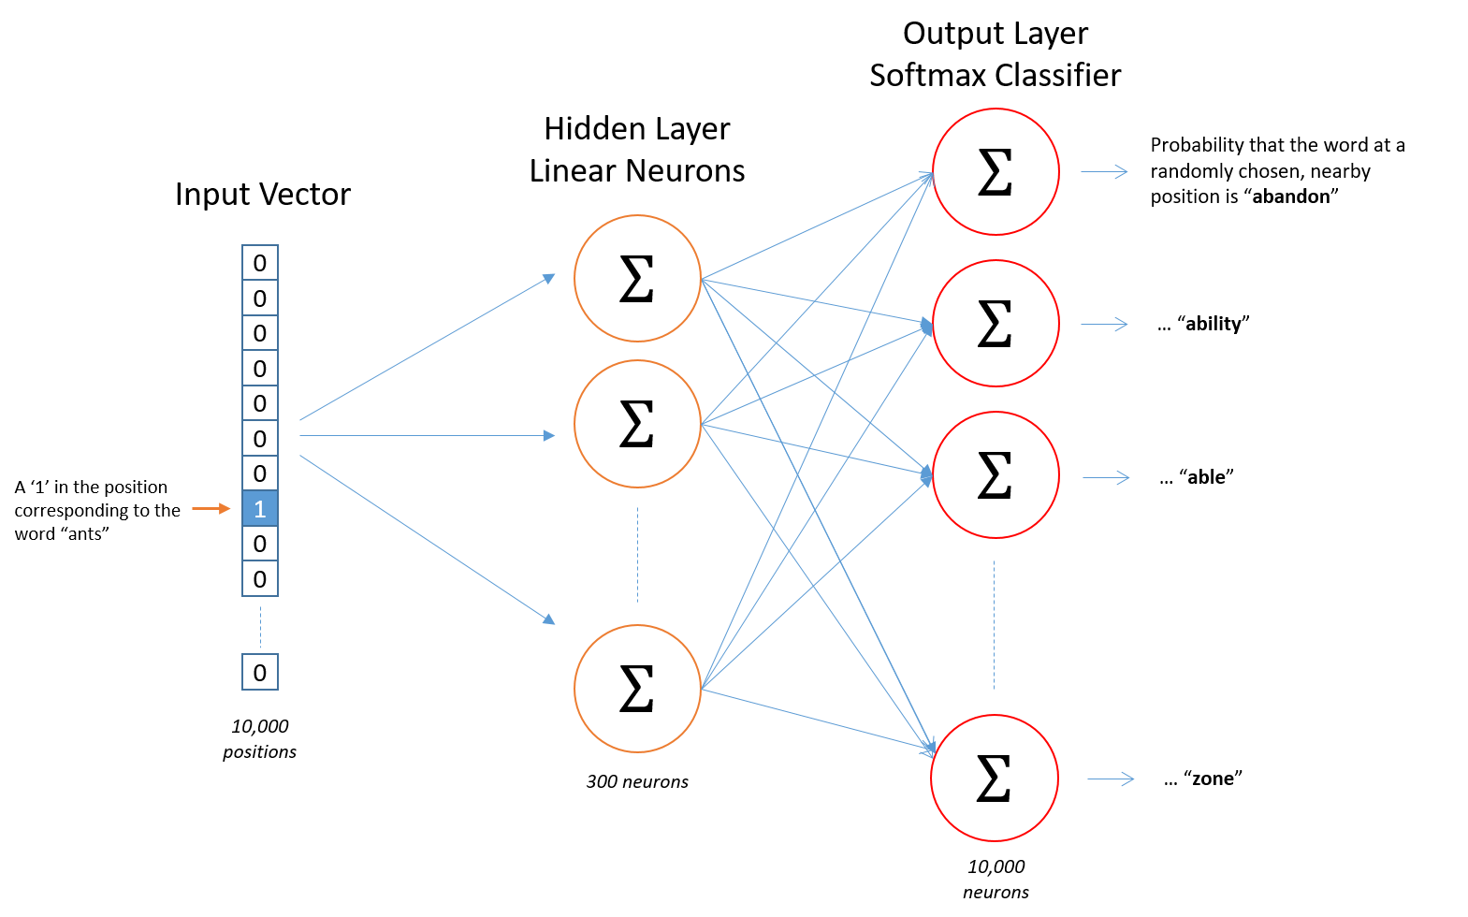

Slide 28
After training
Question:
Suppose you go through every created training examples (set of words (w_{input}, w_{output}).
Then what?
How does this learn weights for the words in our vocabulary?

Slide 29
After training
Question:
How does this learn weights for the words in our vocabulary?
Goal of training: learn hidden layer weights

Slide 30
The Hidden Layer
Let’s say we’re learning word vectors with 300 dimension
So the hidden layer is going to be represented by a weight matrix
10,000 rows (one for every word in our vocabulary) and 300 columns (one for every hidden neuron).
300 features is what Google used in their published model trained on the Google news dataset
The number of features is a "hyper parameter" that you would just have to tune to your application

Slide 31
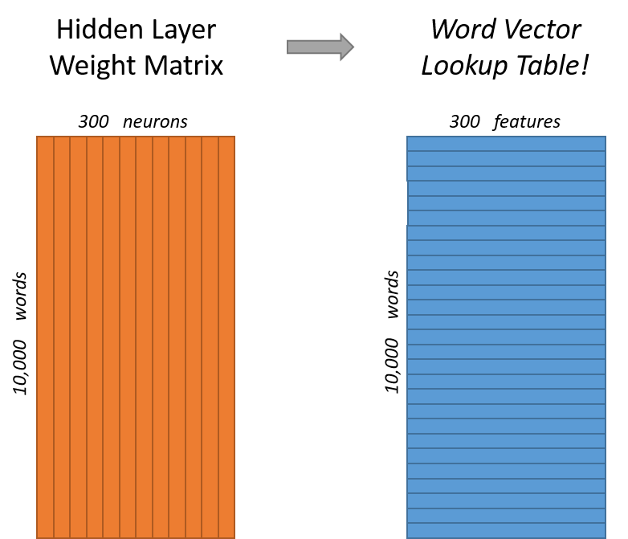
End goal of all of this is really just to learn this hidden layer weight matrix – the output layer we’ll just toss when we’re done!

Slide 32
Skip-Gram Model Network: Intuition
If two different words have very similar “contexts”
Our model needs to output very similar results for these two words
Say we have input words ”lung” and “pancreas”
They have similar context words (“cancer”, “organ”, metastasis”)
and thus similar set of training examples
And thus similar weights for the hidden layer connected to these two words
Thus, similar vectors!

Slide 33
Skip-Gram Model Network: Intuition
One way for the network to output similar context predictions for these two words is if the word vectors are similar
So, if two words have similar contexts, then our network is motivated to learn similar word vectors for these two words!
Synonyms: cancer , carcinoma
Related: lung, pancreas
Same Base form: nsaid, nsaids

Slide 34
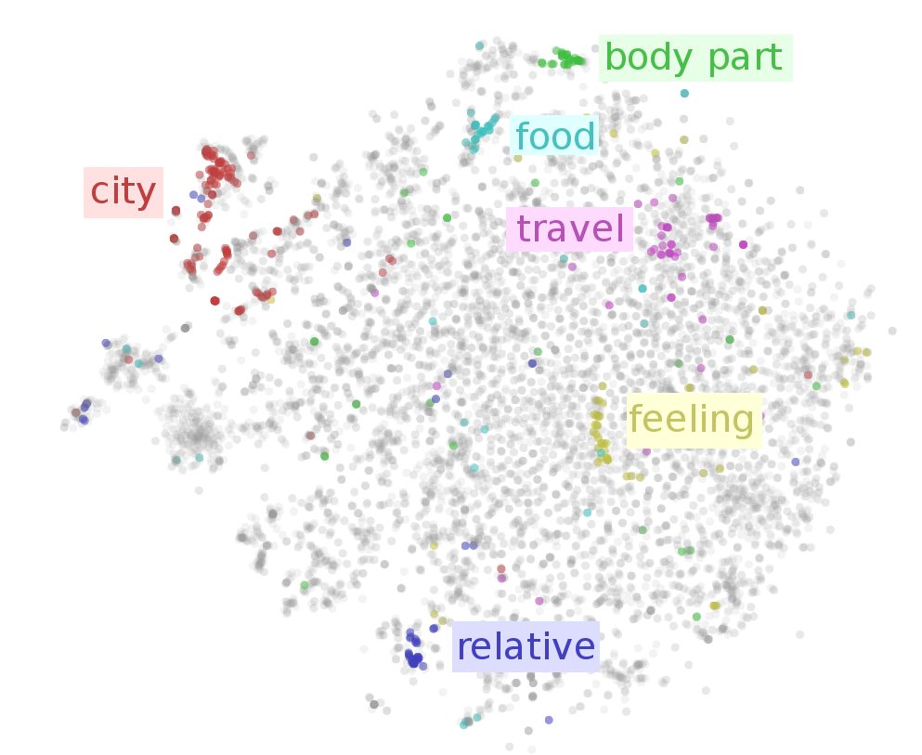

Slide 35
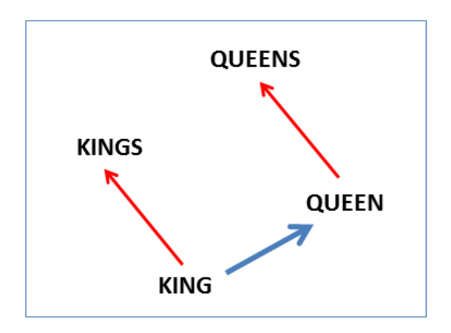
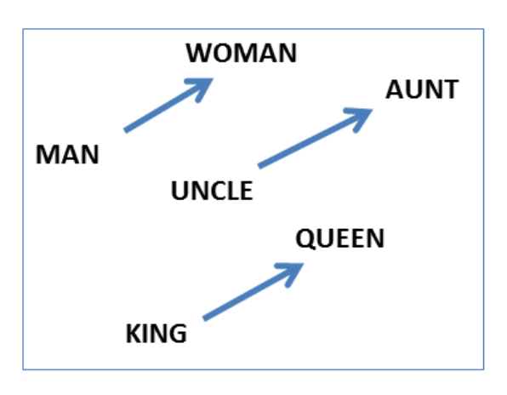
Reasoning with word vectors: Analogies
‘a is to b as c is to ?’ style questions answered by word vectors
Man-> woman : King -> X
Answer by vector offsets
vector(“King”) – vector(“Man”) + vector(“Woman”) = vector(“Queen” =X)

Slide 36
Lab 8: Demo
Training, Loading, word embeddings

Slide 37
Text Classification
Convolutional Neural Nets (CNN)

Slide 38
Motivation
We already have word vectors.
Can we use these to come up with a way to represent the sentence and classify it ?
Eg :- “the patient was given immuno therapy”
We have vectors for “the”, “patient”, “was”, “given”, …“therapy”.
How can we use the vectors for words to get vector for sentence ?

Slide 39
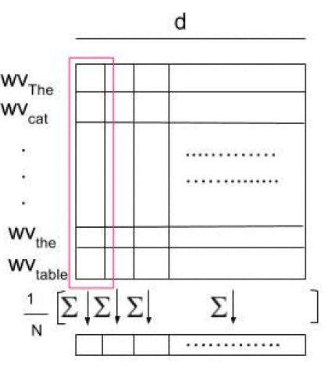
Trivial Approaches
Apply simple reduction techniques to generate vectors/features for the sentence and then apply any well-known ML model (LR, SVM ..)
Mean of word vectors

Slide 40
Fallacies
Different sentences with same words but different ordering will give same vector.
“are you good” vs “you are good”
Negation - opposite meaning but very similar words
“I do want a car” vs “I don’t want a car”
Sentence vector generated via simple operations on word vectors - often do not capture syntactic and semantics properties.

Slide 41
Solution: Convolutional Neural Nets
CovNet or CNN
CNN were initially developed in the neural network image processing community
Recognizing an object from a pre-defined category (e.g., cat, bicycle, etc.).
CNN typically involves two operations, which can be thought of as feature extractors that work on 2D input
convolution
pooling

Slide 42
Convolutional Neural Nets (CNN)
Motivation through Image Classification

Slide 43
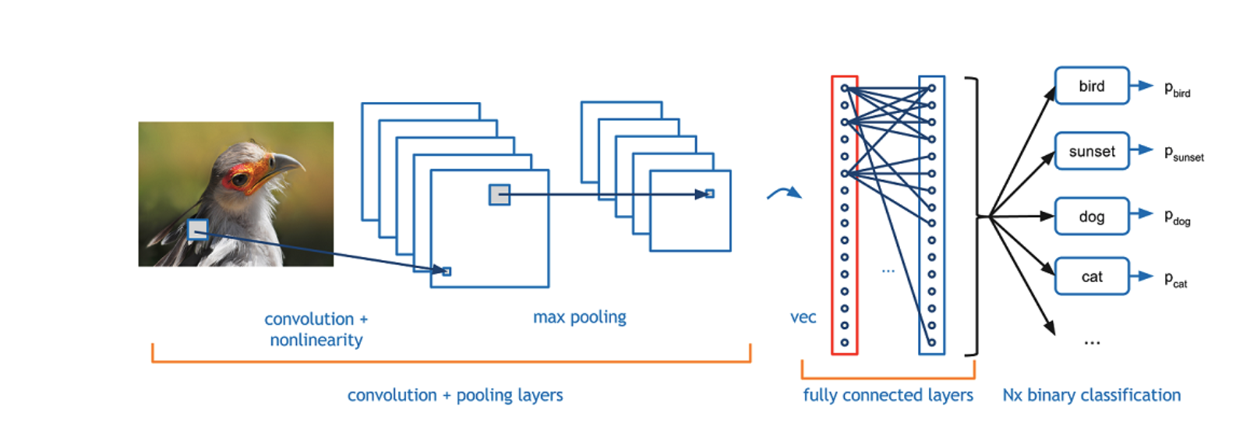
CNN Architecture for Image Classification

Slide 44
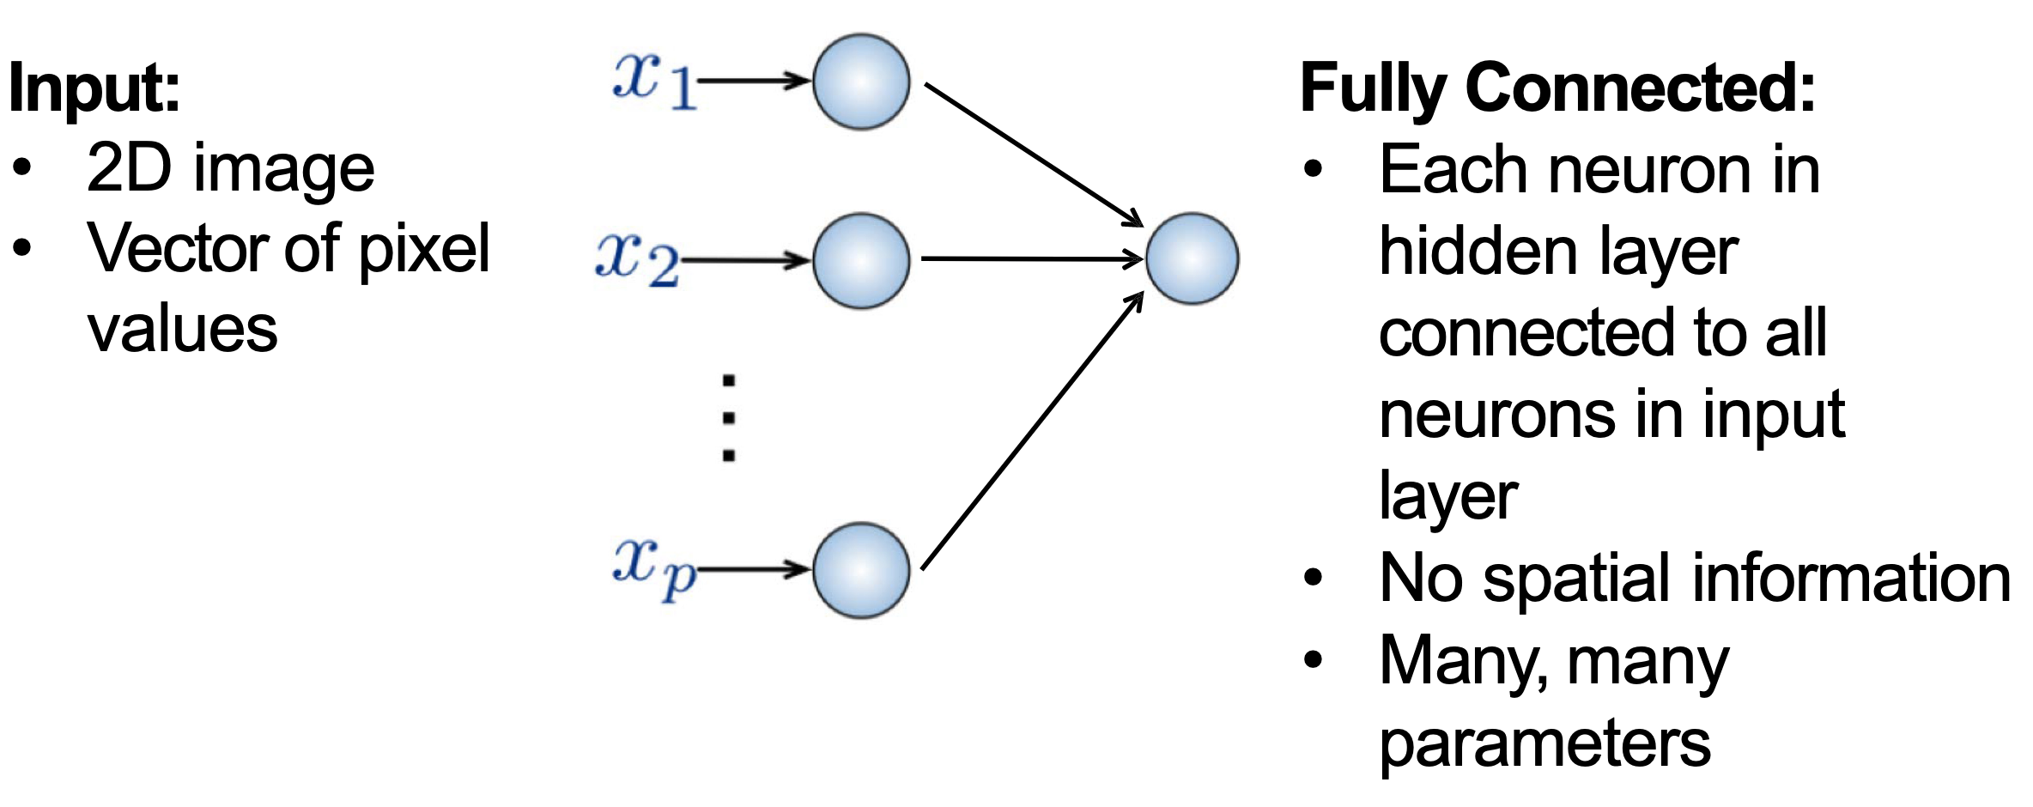
Traditional Fully Connected Neural Network
Use local spatial structure of the 2D input

Slide 45
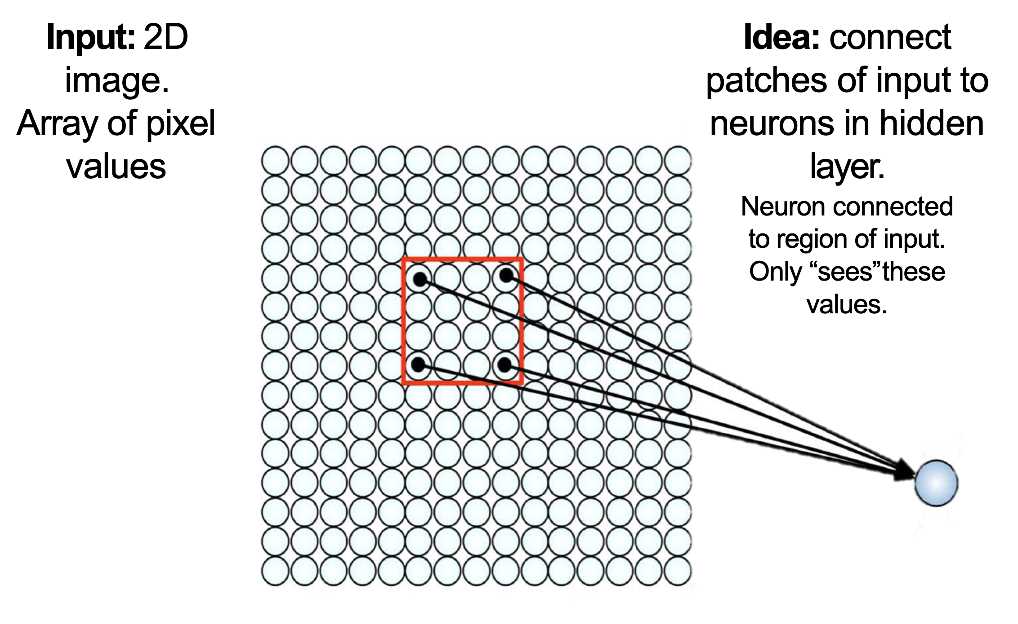
CNN Intuition: Compute Local Spatial features

Slide 46
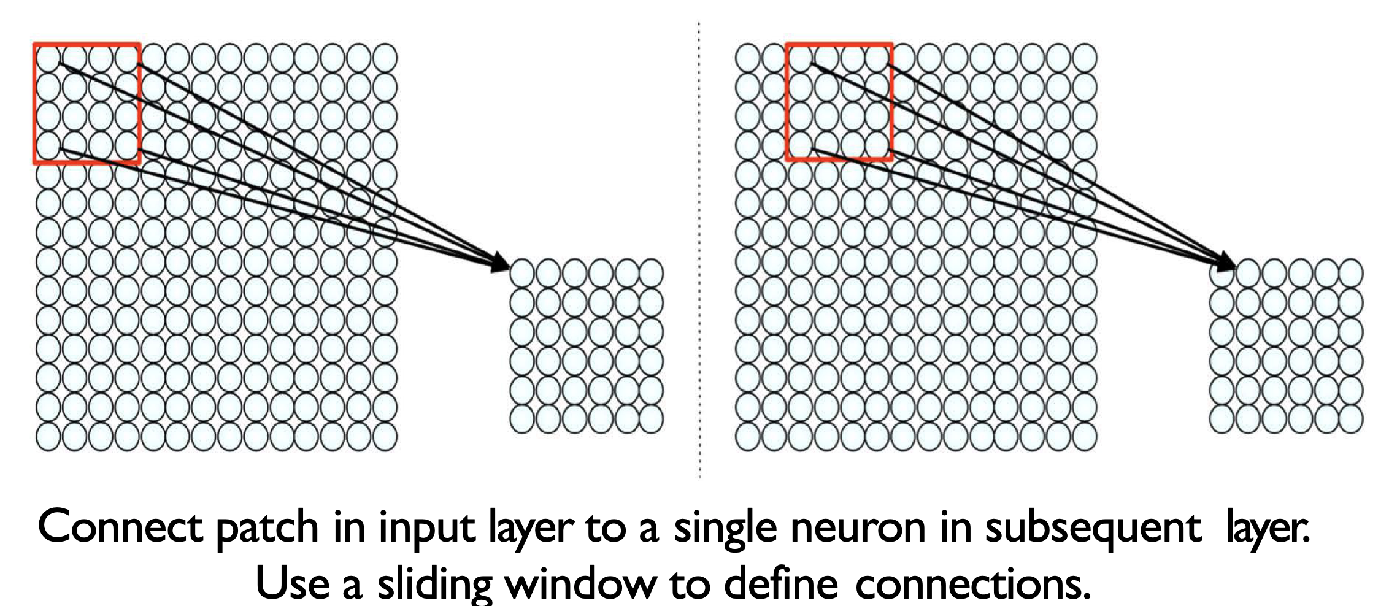
CNN Intuition: Convoluted features

Slide 47
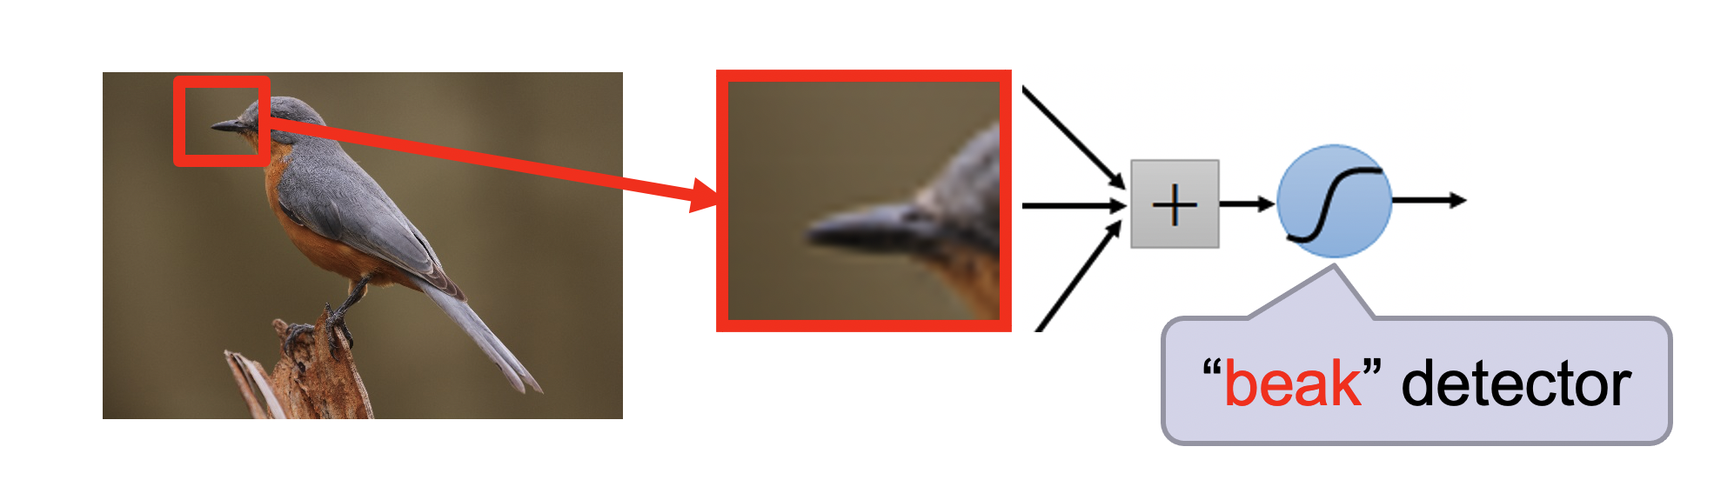
Convoluted features: High Level Feature

Slide 48
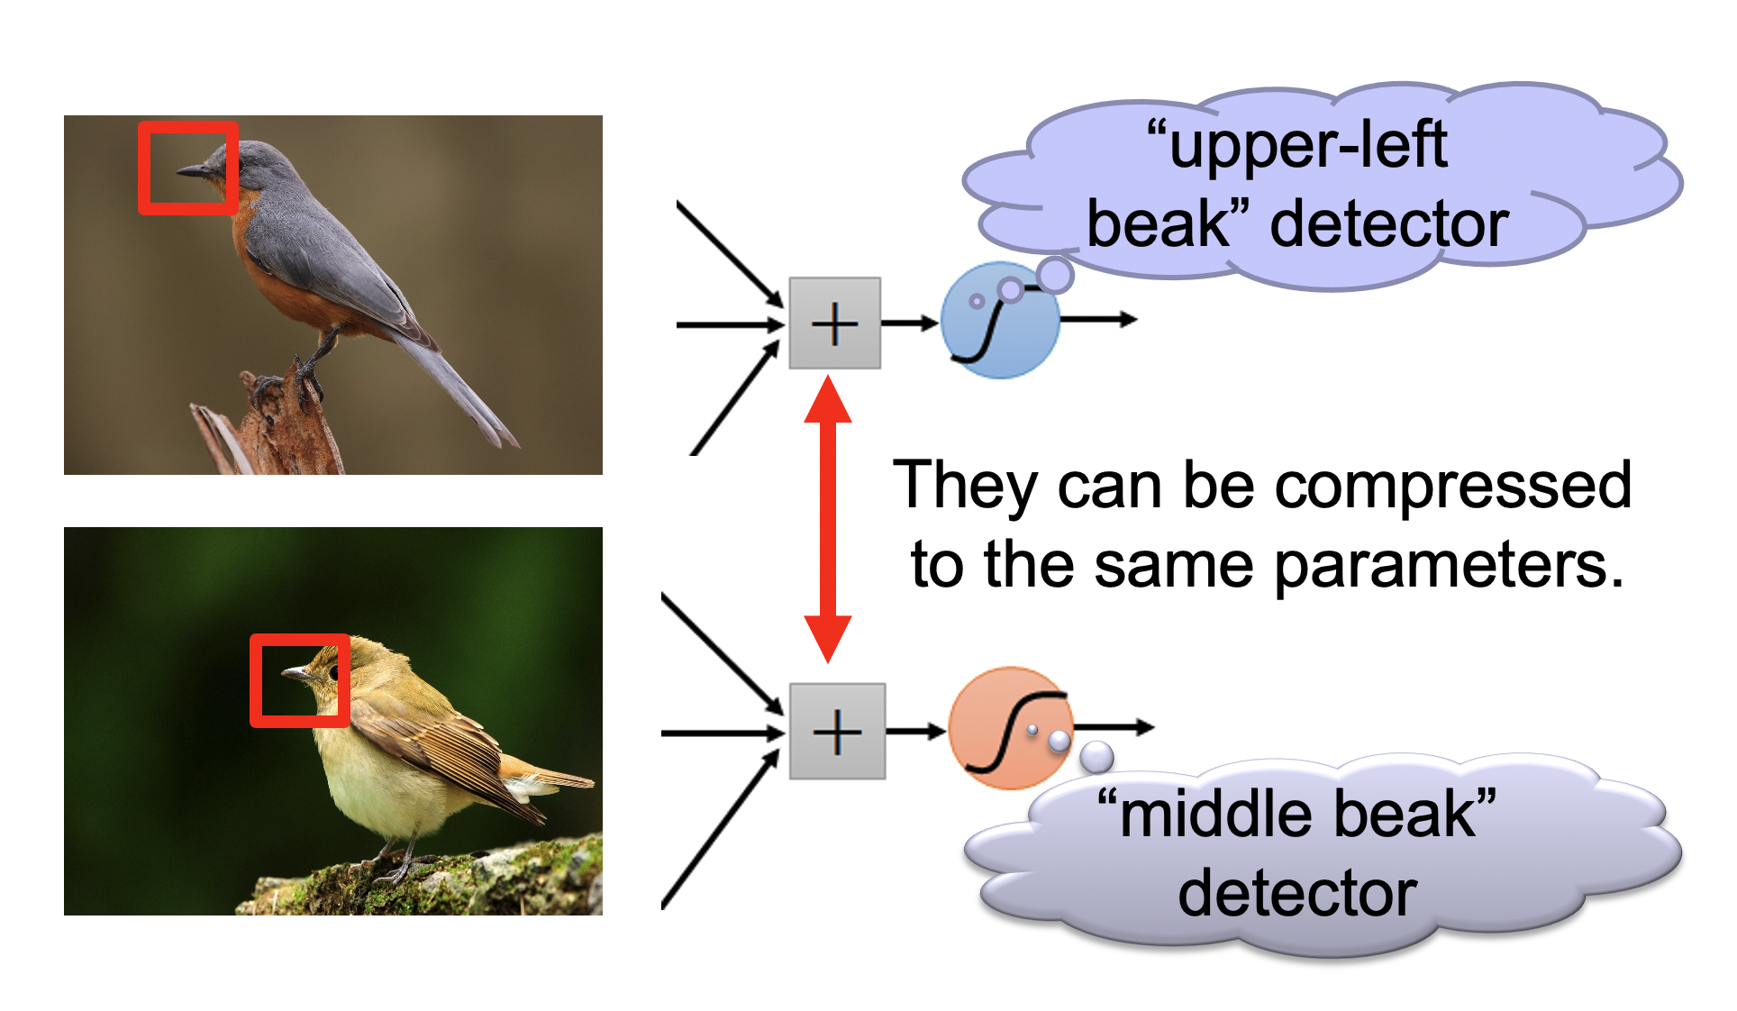
Multiple Convolutions
Hand written digit CNN demo: https://adamharley.com/nn_vis/

Slide 49
Convolution
A filter (2D) of some size slides over the 2D data
This filter is 2D matrix of weights
Each sliding operation => dot product => one scalar value
After all sliding operations => a 2D convoluted feature = > some local feature
Automatic feature generation
Learns some aspects of the input (image, text)

Slide 50
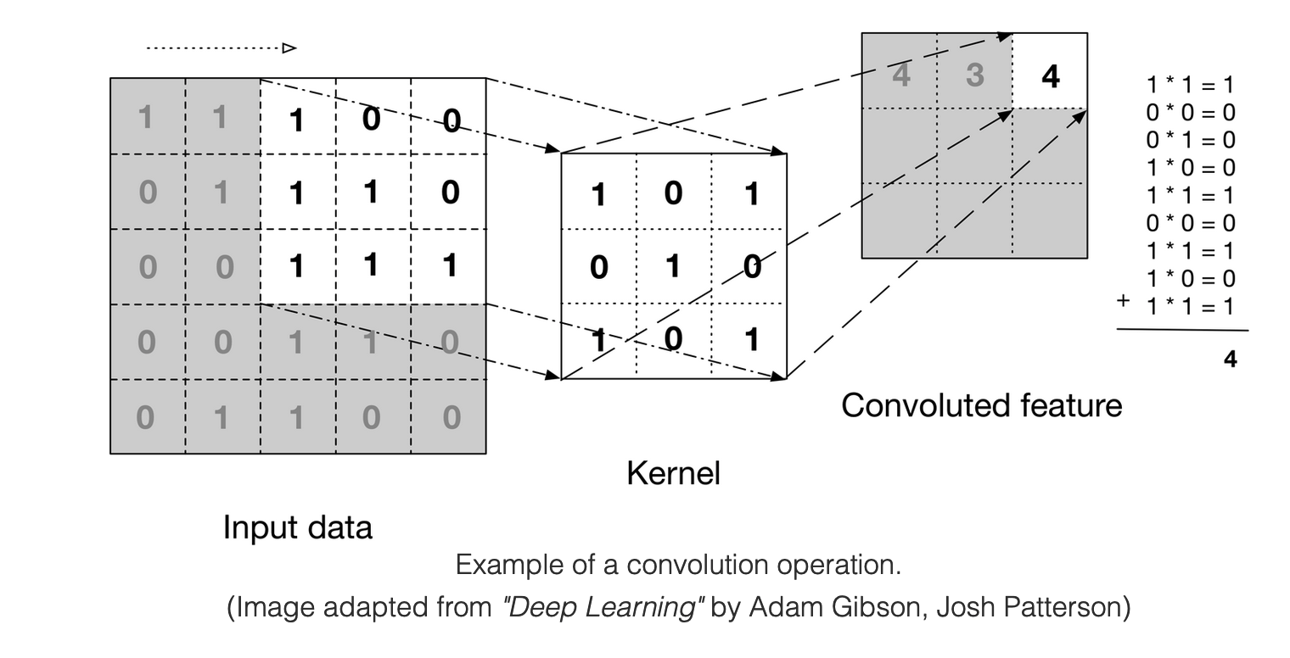
Convolution Example

Slide 51

Sliding operation: Example

Slide 52
Pooling
After obtaining features using convolution, we would next like to use them for classification.
But there will be a lot of convoluted features, because
We typically use a lot of different convolution kernels (128, 256..)
Of different sizes (3, 5, 7 ..)
Learning a classifier with these many convoluted features (typically in millions) is computationally slow and prone to overfitting
Solution: Pooling

Slide 53
Pooling
convolved features => “stationarity” property of a subset of input
Pooling => aggregate statistics of these features at various locations
Compute the mean (or max) value of a particular feature over a region of the image.

Slide 54
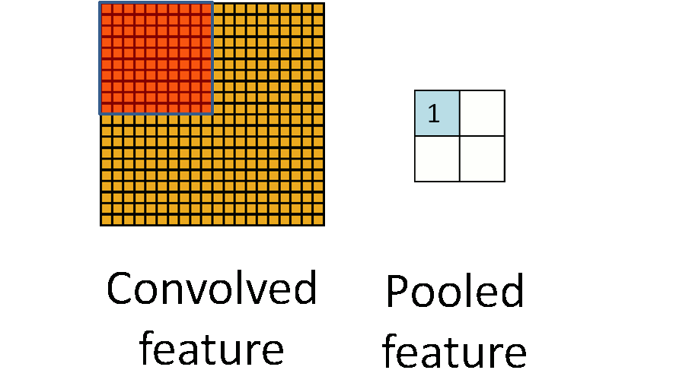
Pooling

Slide 55
CNN for Text classification

Slide 56
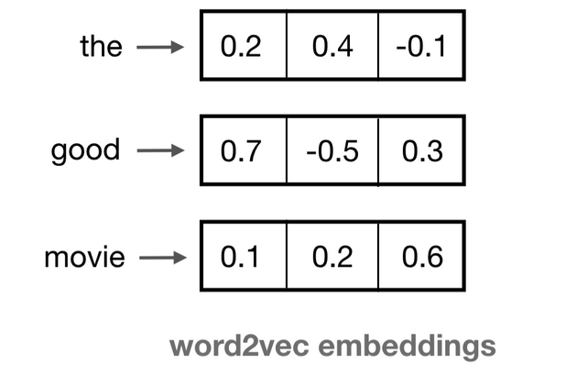
Input: Embedding Space
A 2D matrix, where each word is represented by a fixed dimension vector

Slide 57
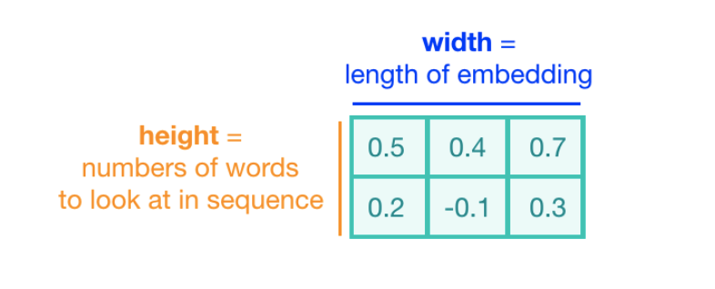
Convolution Kernel
The height of the kernel will be the number of embeddings it will see at once, similar to representing an n-gram in a word model => kernel size (2 here)
The width of the kernel should span the length of an entire word embedding.

Slide 58
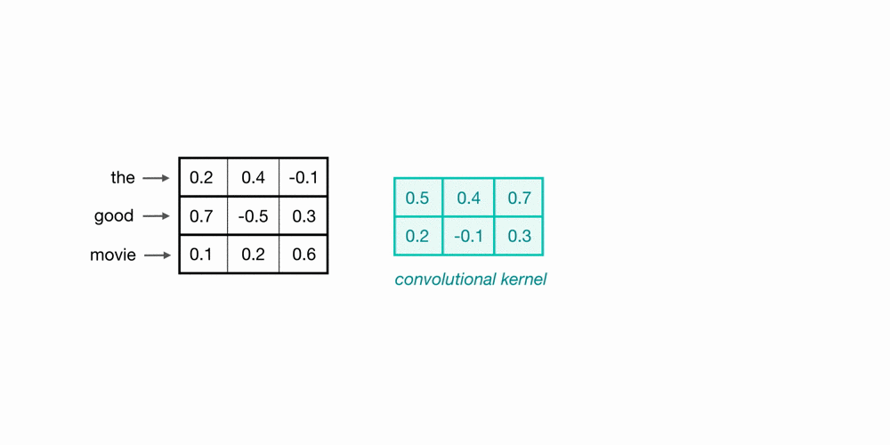
Convolution over Word Sequences
Kernel size = 2
What is this particular convolution step learning?

Slide 59
Convolution over Word Sequences
Kernel size = 2
What is this particular convolution step learning?

Slide 60
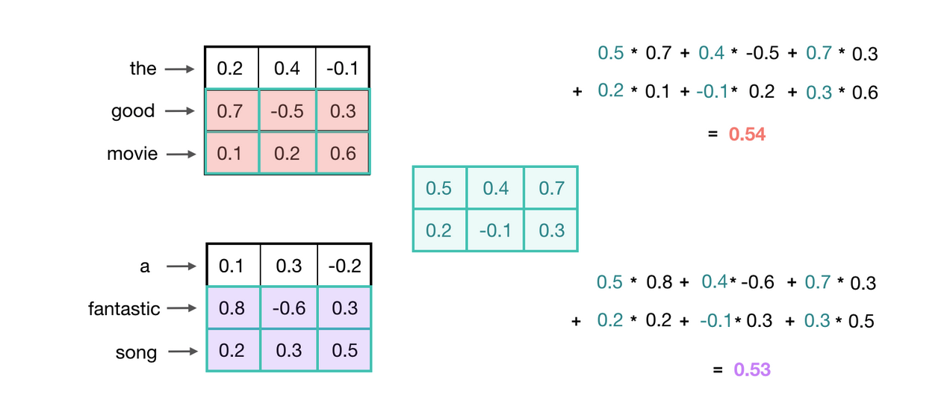
Recognizing General Patterns
Learning 2 grams, which indicative of a positive sentiment?

Slide 61
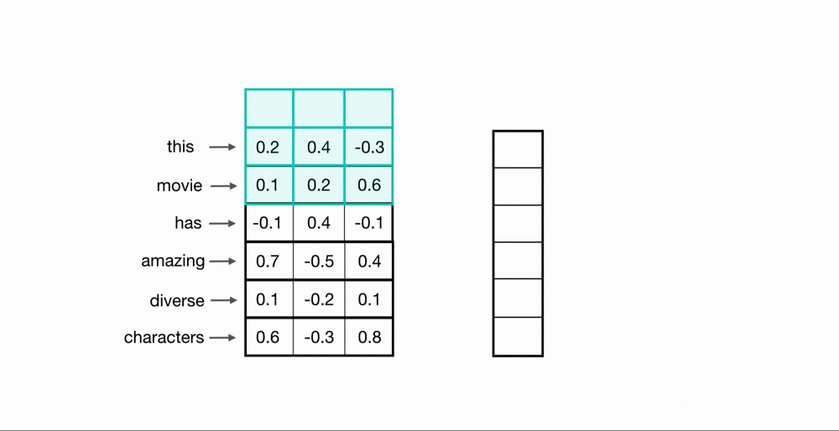
Convolution over the entire sentence

Slide 62
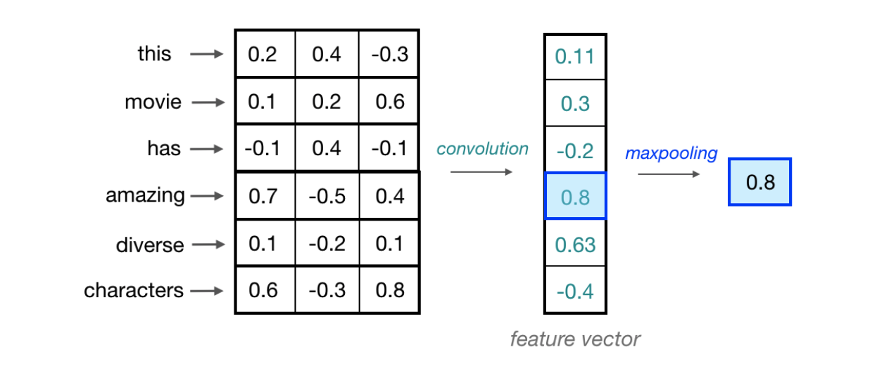
Maxpooling over time

Slide 63
Multiple Kernels
One convolutional kernel is not enough to detect all the different kinds of features that will be useful for a classification task.
Need multiple kernel of different sizes to automatically learn local features
Typical kernel sizes: 3, 5, 7,
Number of kernels: 64, 128, 256, 512

Slide 64
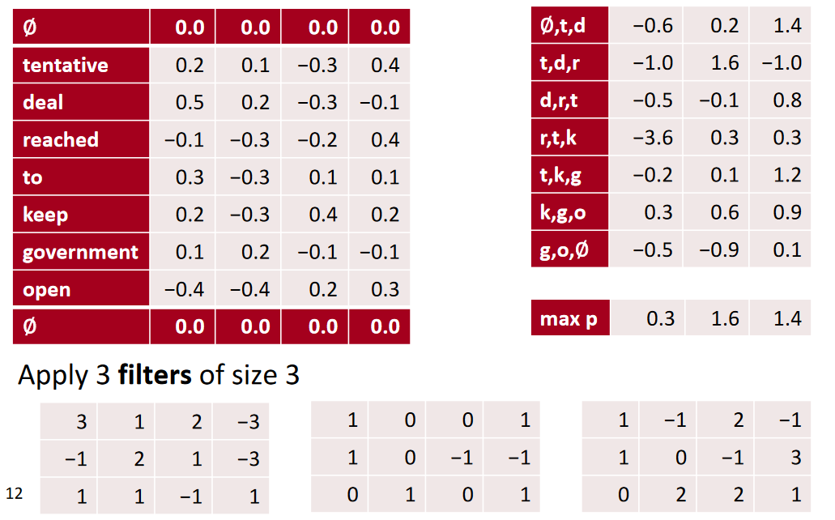
conv1d, padded with max pooling over time

Slide 65
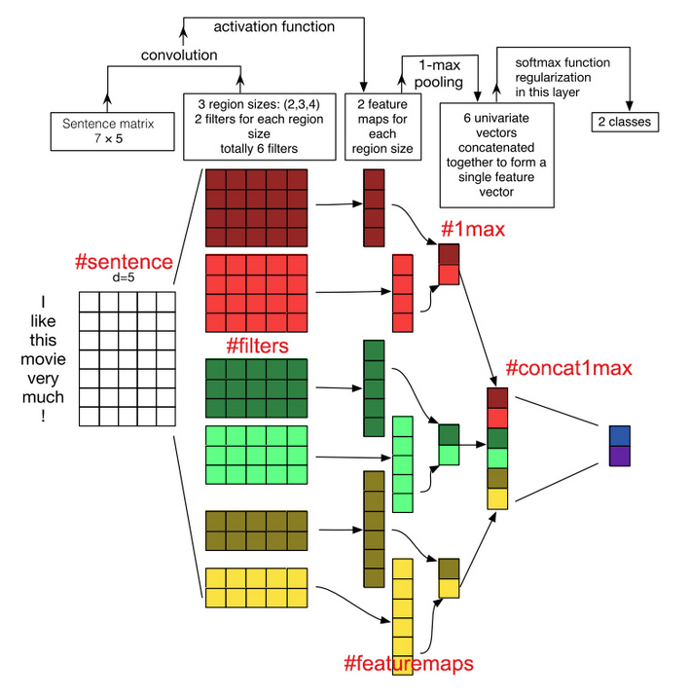

Slide 66
Demo
Lab 8: Text Classification using Neural Networks

